Slide 1
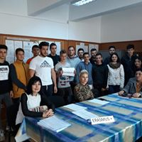
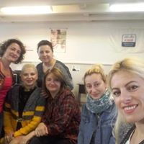
PECHAKUCHA Project Nr: 2018-1-RO01-KA229-049348_1 ”THE ROLE OF ICT TOOLS IN MOTIVATING LEARNING AND INCREASING THE QULAITY OF EDUCATION” "Material produced with the financial support of the European Commission. The content of this material is the exclusive responsibility of the authors, and the National Agency and the European Commission are not responsible for how the content of the information will be used. "
The coordinating team from Romania
Panevėžio 5-oji gimnazija, Panevėžys, Lithuania
Liceul Tehnologic Dacia Pitesti, Romania
BURDUR MESLEKI VE TEKNIK ANADOLU LISESI Burdur, Turkey
LICEO SCIENTIFICO STATALE "MICHELE GUERRISI" Cittanova, Italy
Liceul Tehnologic Dacia Pitesti, Romania

Slide 2
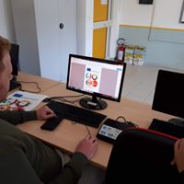
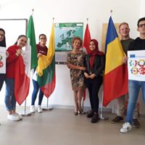
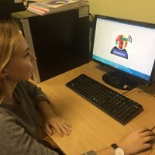
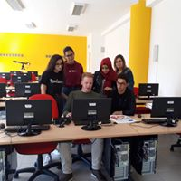
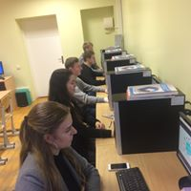
The logo of the project selected following the competition was the one developed by the Italian team

Slide 3
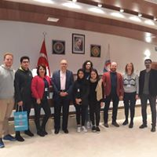
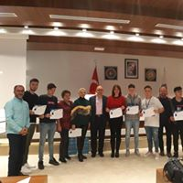
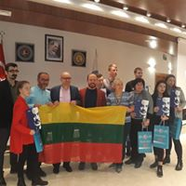
Learning Teaching Training – Turkey, Burdur 18th-24th November 2018 - Programming with STEM

Slide 4
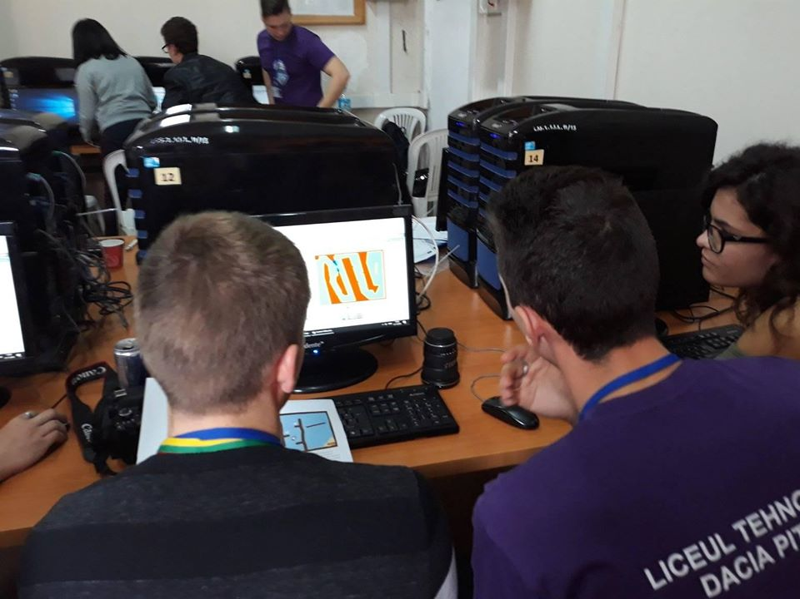
Scratch – Coding Lessons – LTT Turkey

Slide 5
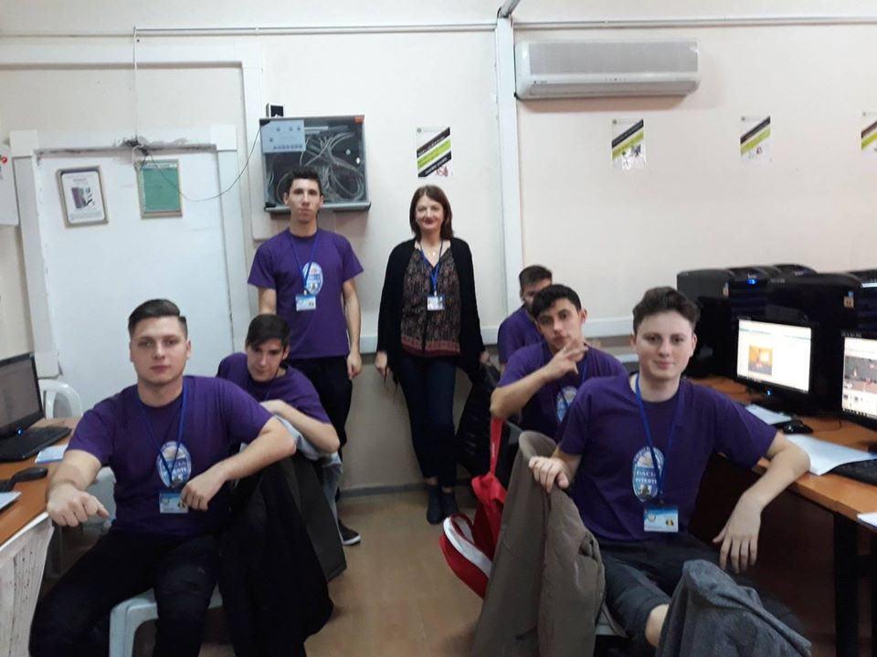
Scratch – Coding Lessons – LTT Turkey

Slide 6
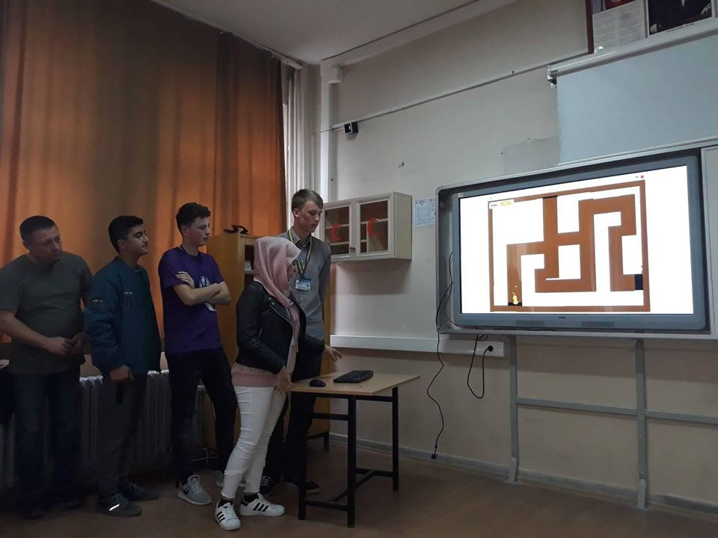
Scratch – Coding - LTT Turkey Working in international teams

Slide 7
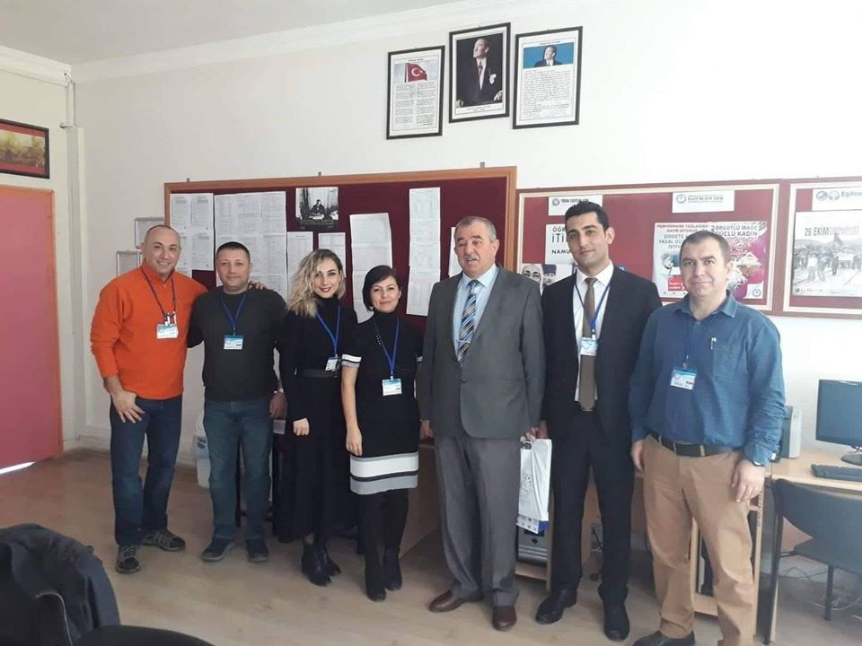
Learning Teaching Training – Turkey, Burdur A great team that organized successful mobility

Slide 8
Learn to program by creating simple animations using the Scratch computer code to tell stories, create games, and share ideas

Slide 9
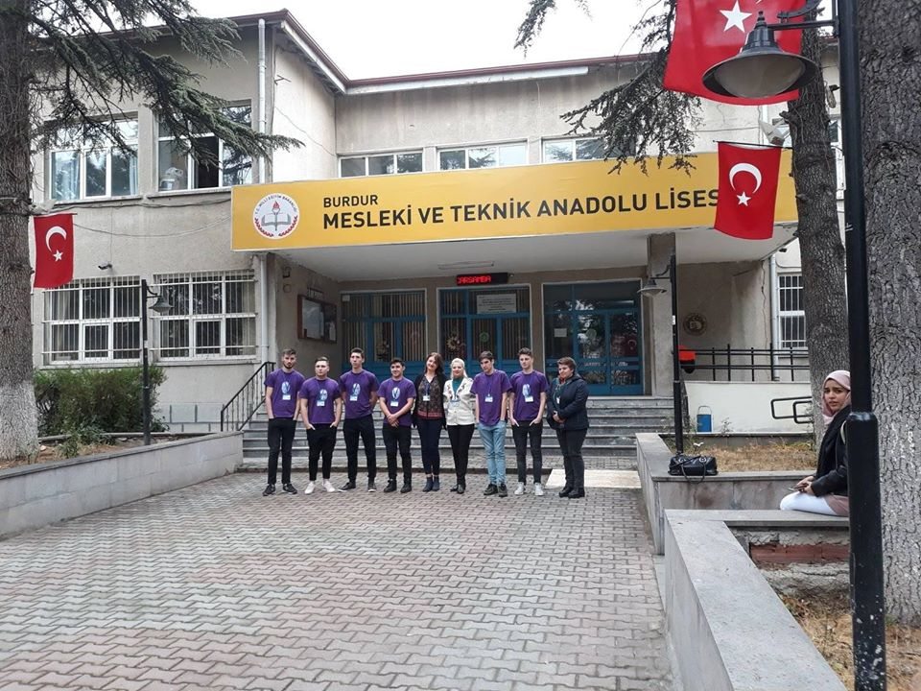
Teamworking people with a different culture and concept of life will contribute to the consolidation of the European values and principles of the participants, to their integration into the European space.

Slide 10
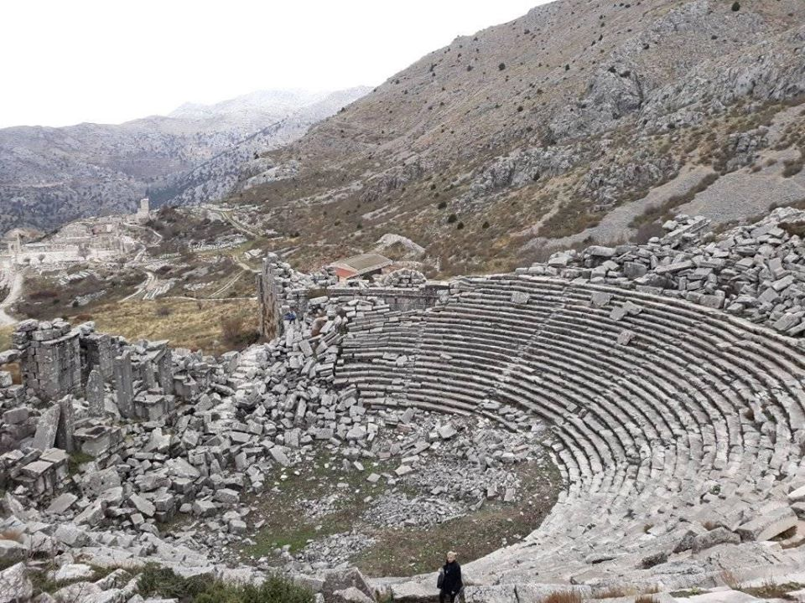
Sagalassos – Turkey We learned about the culture, history and traditions of the Turkish people

Slide 11
Learning Teaching Training – Cittanova, Italy We learning the programming language Visual Basic Application (VBA) for digital innovation.

Slide 12
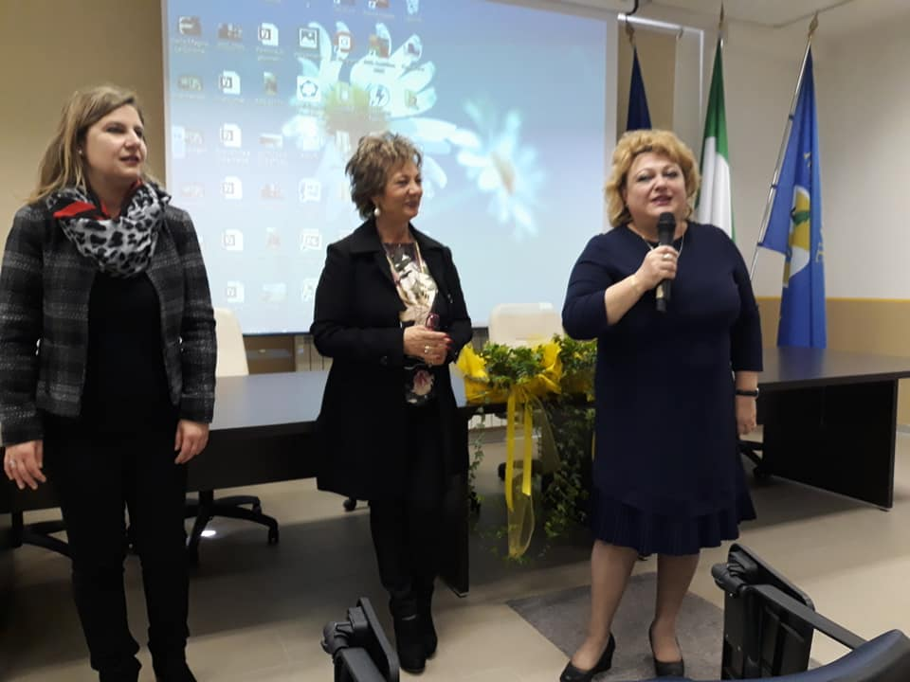
Learning Teaching Training - Italy, Cittanova A warm welcome!

Slide 13
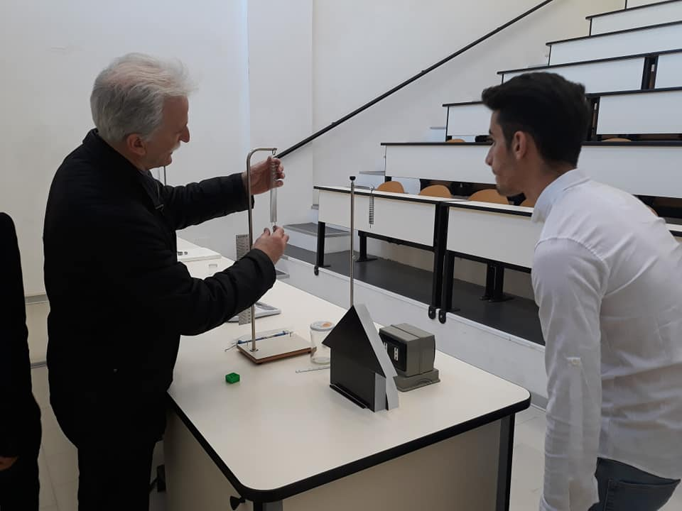
Motivating and finding solutions through Visual Basics - Italy

Slide 14
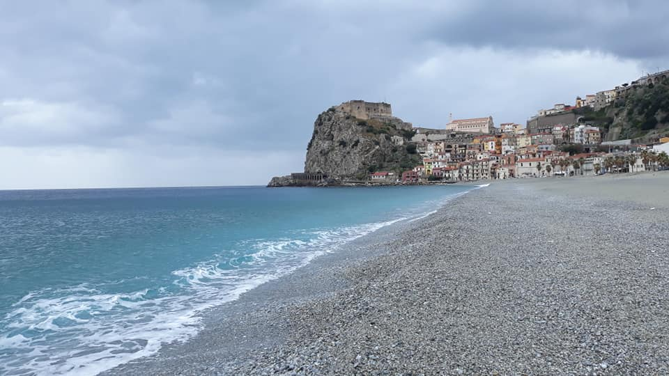
Reggio Calabria - Scilla , Italy The history of beautiful places in Calabria

Slide 15
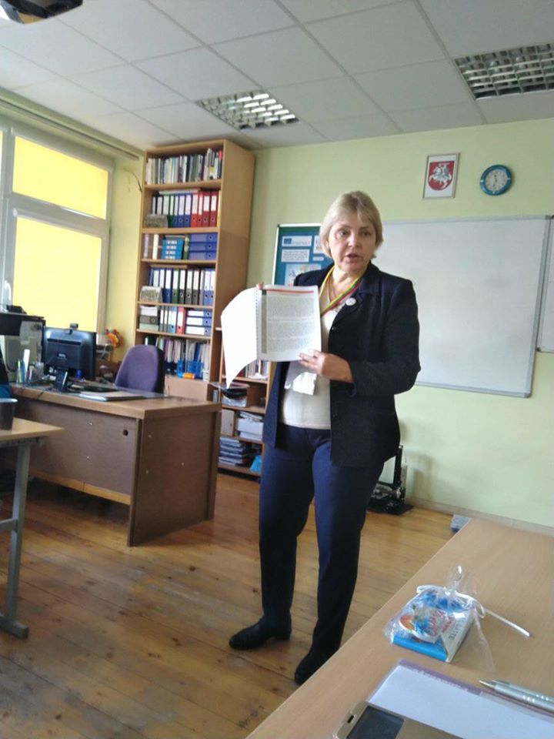
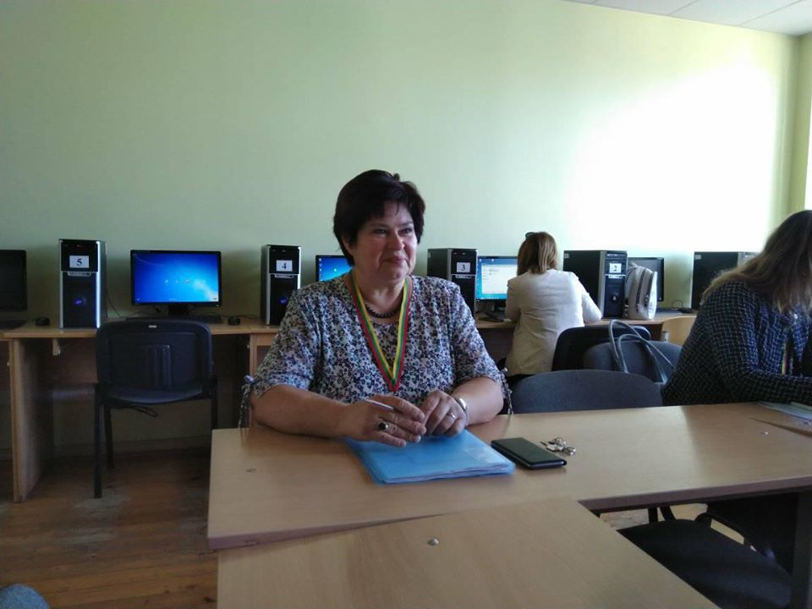
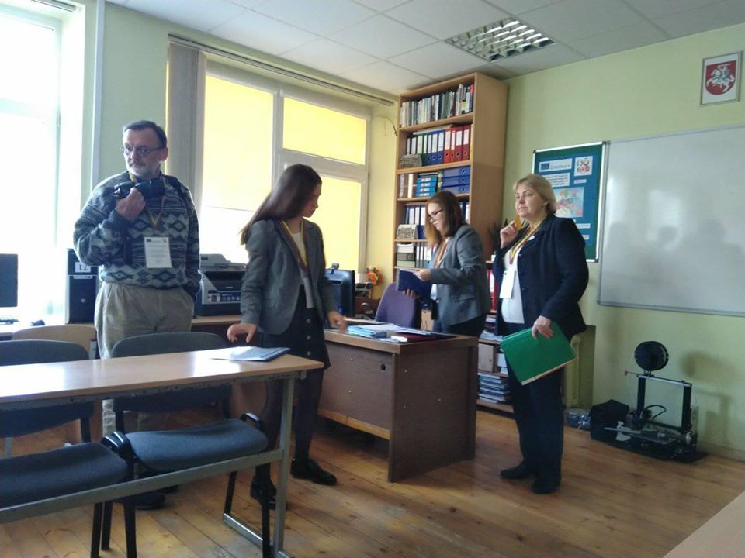
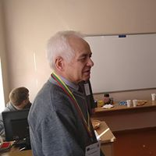
Learning Teaching Training – Panavezys Lithuania 29 th September – 5th October 2019

Slide 16
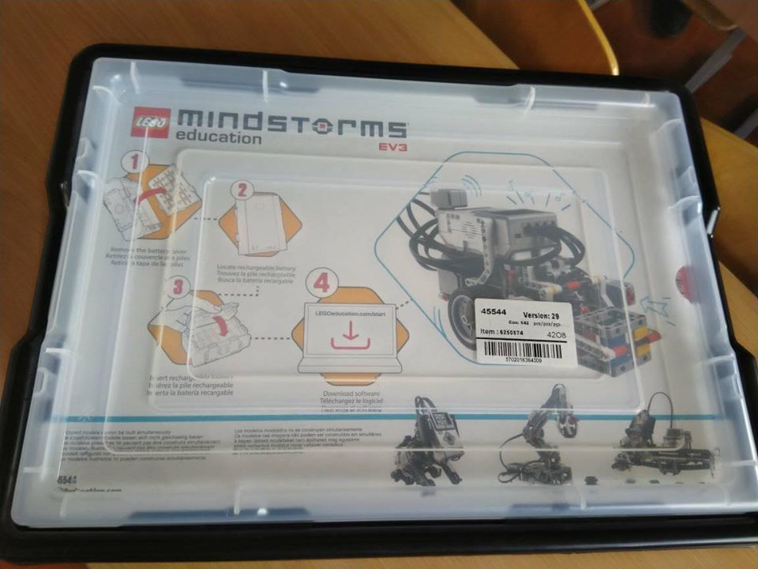
Build moving robots based on LEGO Mindstorms EV3 - Lithuania

Slide 17
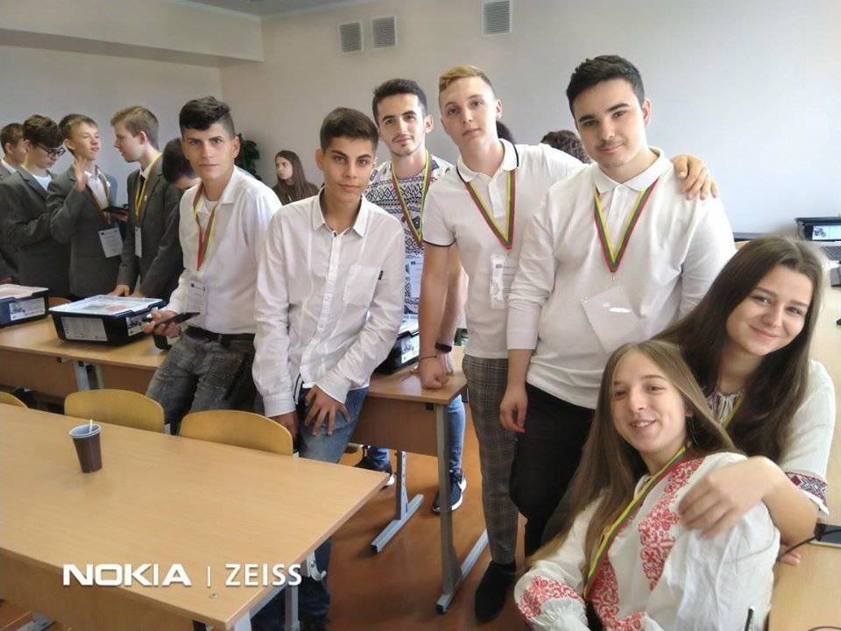
We learn to build moving robots based on LEGO Mindstorms EV3 - Lithuania

Slide 18
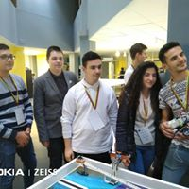
The presentation of projects of international teams - moving robots based on LEGO Mindstorms EV3

Slide 19
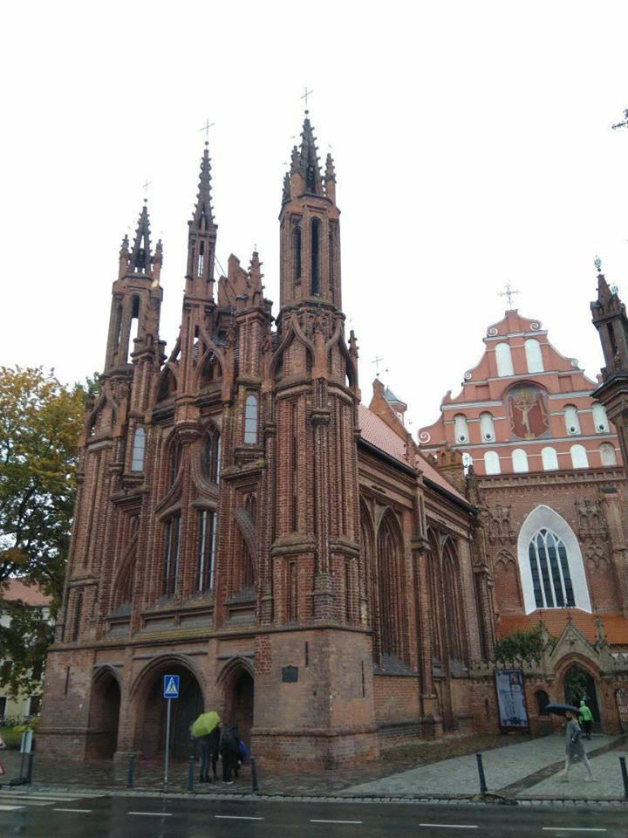
Vilnius – Lithuania The history of beautiful places

Slide 20
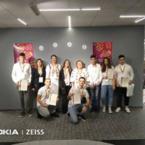
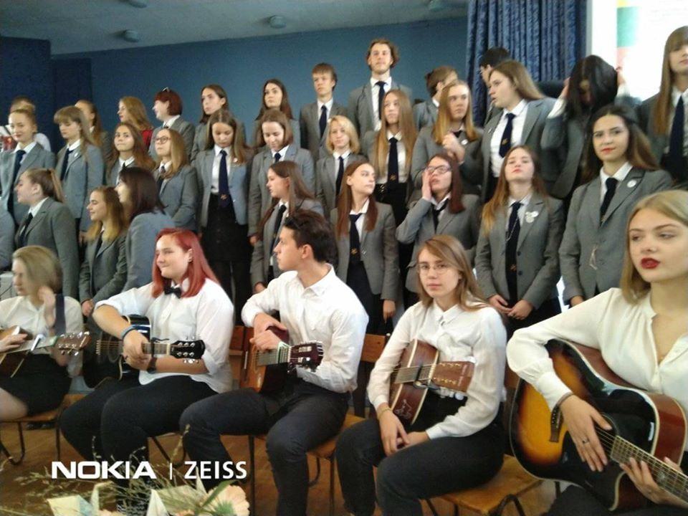
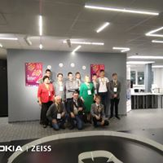
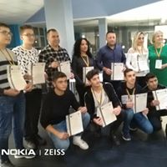
Beautiful moments, friendship and partnership - US ICT Was awesome!

